Slide 1
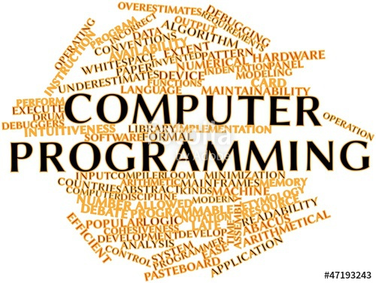
So what is computer programming?

Slide 2
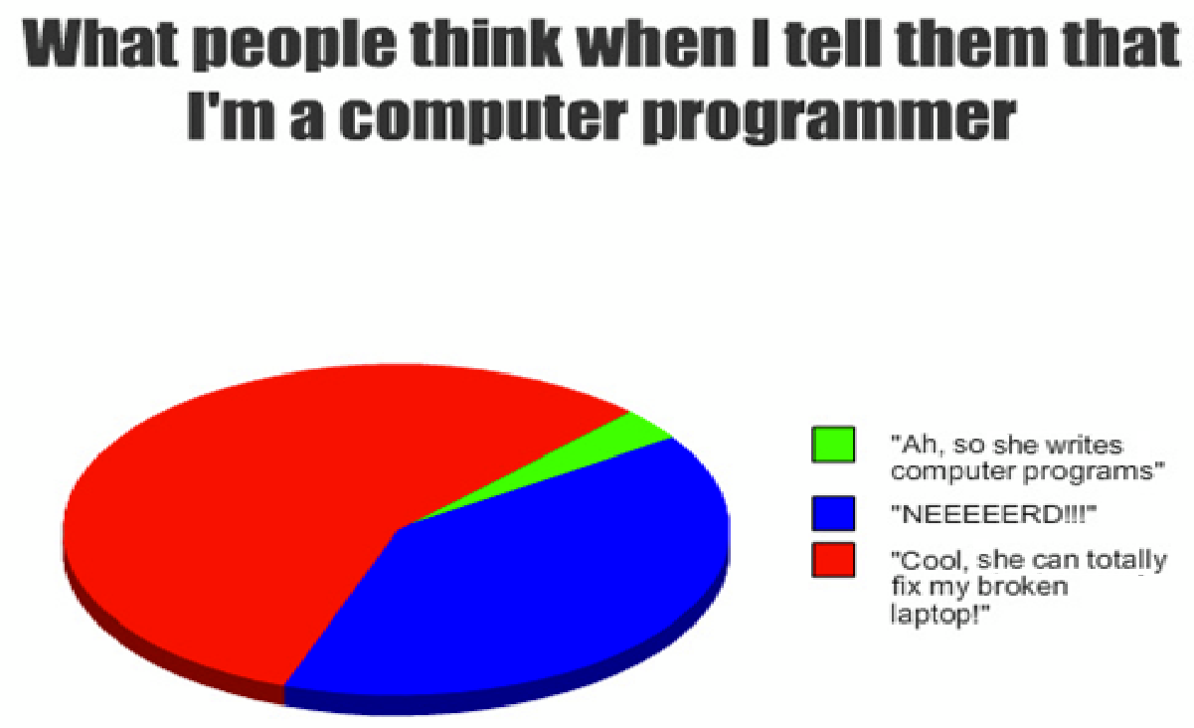
Computer Programming

Slide 3
Computer Programming
In writing a computer program, you basically write a series of instructions for the computer to follow…. Simple as that!
You then compile your list of instructions so that it is in a format the computer will understand.
When you run your program, the computer follows the instructions to execute your code.

Slide 4
Computer programming
Computer programming involves some problem solving skills.
First we see what it is we are being asked to solve.
We then think about what we need in order to solve the problem.
We break our solution into a series of simple instructions.
Once we have done that, we convert our instructions to a coding language.

Slide 5

Computer Programming

